Slide 1
Food Trends Understanding Customer Preferences in FB
Name: Krishna Kumar SHARMA Tool Used: Power BI

Slide 2
Introduction
In today’s competitive restaurant industry, understanding customer preferences and sales performance is essential for growth. Restaurants generate large volumes of data through orders, ratings, and customer feedback. However, raw data alone cannot provide meaningful insights without proper analysis. This project uses Microsoft Power BI to transform restaurant data into interactive dashboards and actionable insights. By analyzing food trends, customer sentiment, and product performance, we can identify best-selling products, measure customer satisfaction, and evaluate revenue drivers. The goal of this project is to support data-driven decision-making that enhances customer experience and improves overall business performance.

Slide 3
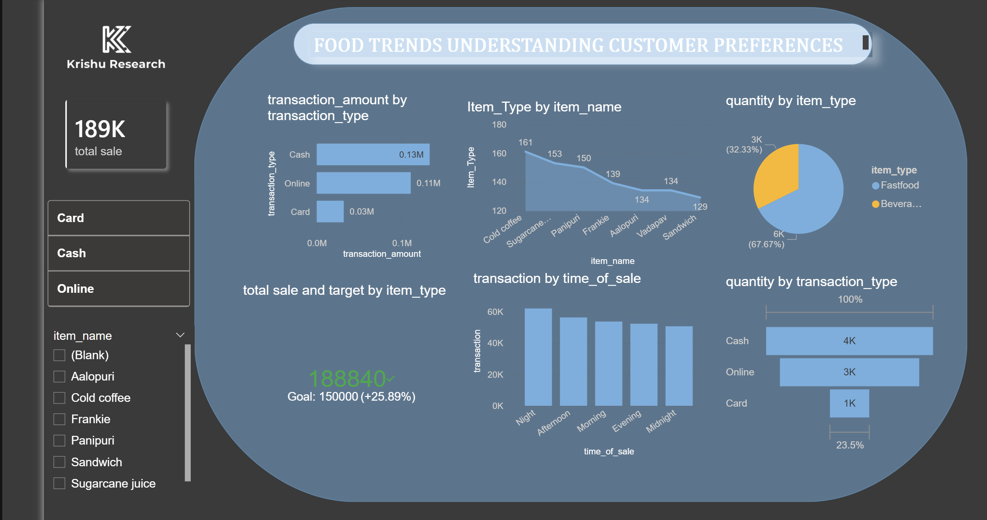
Dashboard

Slide 4
Project Objectives
The main objective of this project is to analyze restaurant data to gain meaningful business insights. This project focuses on understanding food trends and identifying customer preferences based on sales and rating patterns. It also aims to evaluate customer sentiment by analyzing positive, neutral, and negative feedback.
Additionally, the project measures key performance indicators such as total revenue, total sales, average rating, and top-selling products. By using interactive dashboards, the goal is to support data-driven decision-making, improve customer satisfaction, and enhance overall restaurant performance.

Slide 5
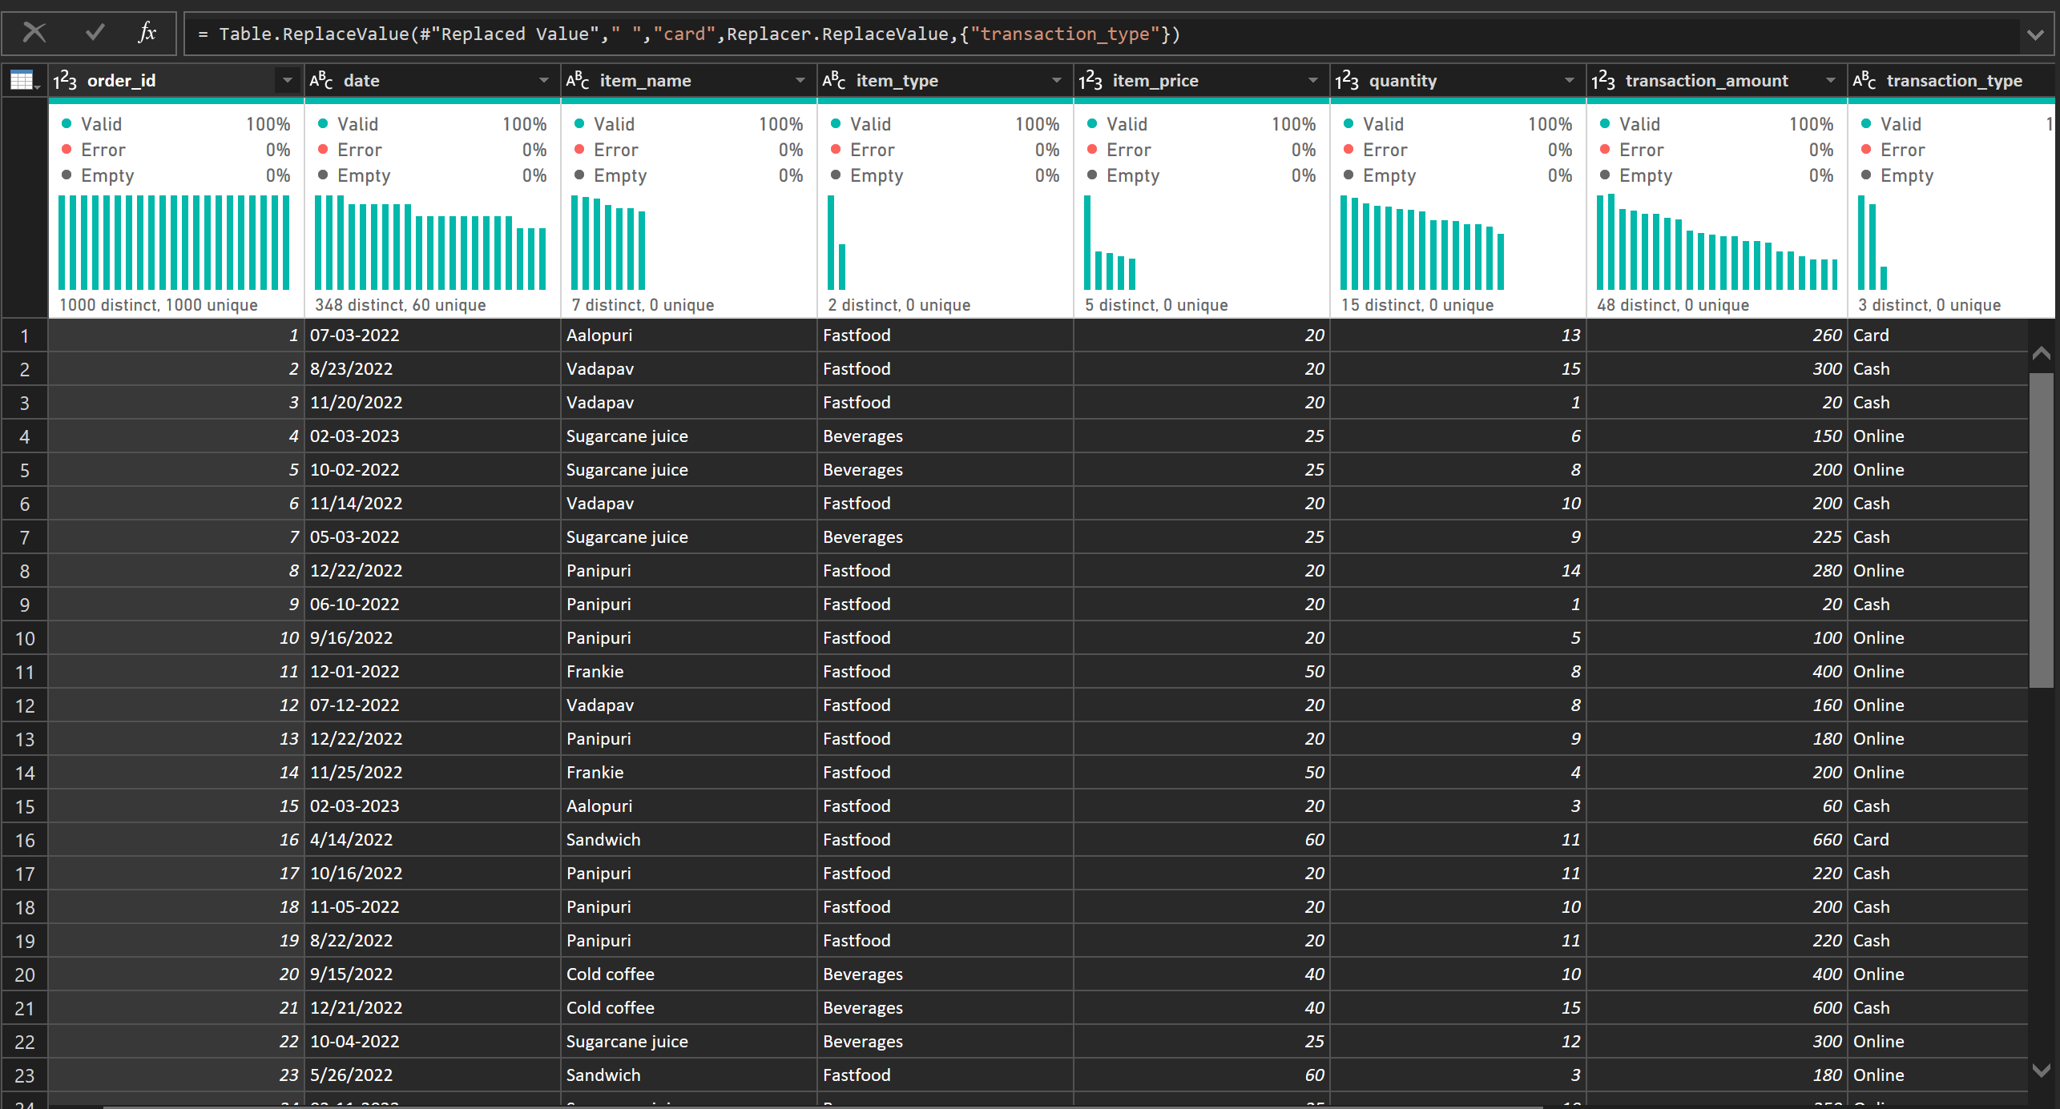
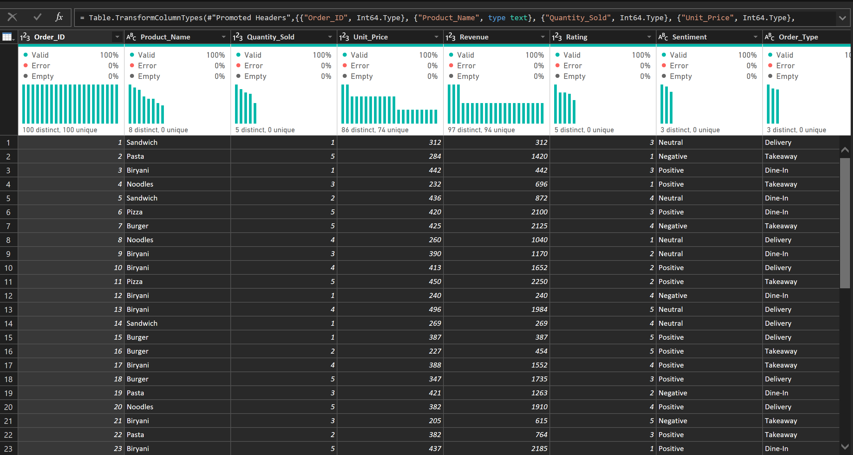
Dataset Overview The dataset used in this project contains structured restaurant sales and customer feedback data. It includes important fields such as Order ID, Product Name, Quantity Sold, Unit Price, Revenue, Rating, Sentiment, Order Type, and Order Date. This data helps analyze product performance, customer satisfaction, and revenue trends. The structured format allows efficient data modeling, KPI calculation, and visualization in Power BI. By organizing and cleaning this dataset, meaningful business insights can be generated to support decision-making and performance improvement.

Slide 6
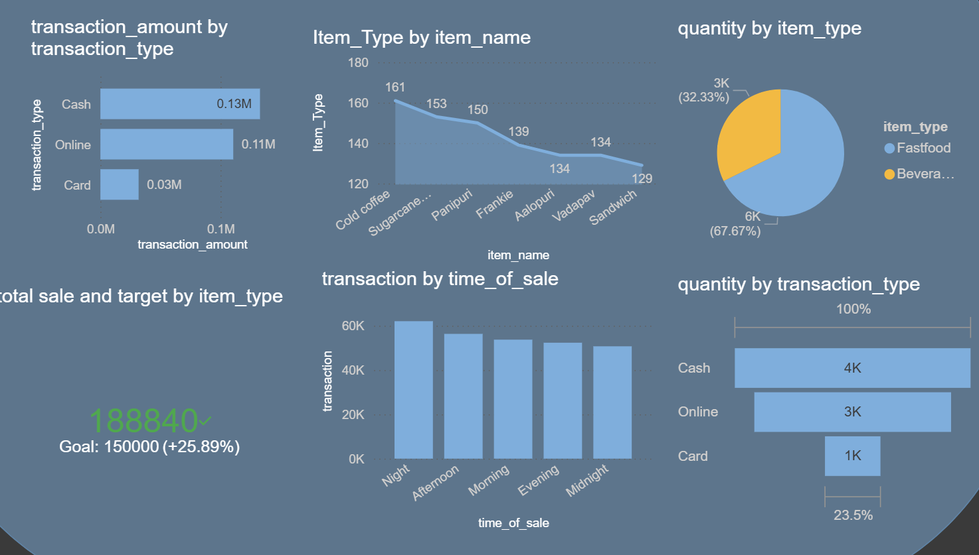
Food Trends: Understanding Customer Preferences
Food trends are identified by analyzing product-wise sales and customer ratings. By examining the quantity sold for each product, we can determine which menu items are most popular among customers. Revenue analysis further helps identify which products contribute the most to overall income.
This analysis reveals customer preferences and demand patterns. High-selling products indicate strong customer interest, while low-selling items may require improvement in pricing, quality, or promotion. Understanding these trends enables the restaurant to align its menu strategy with customer demand and increase profitability.

Slide 7
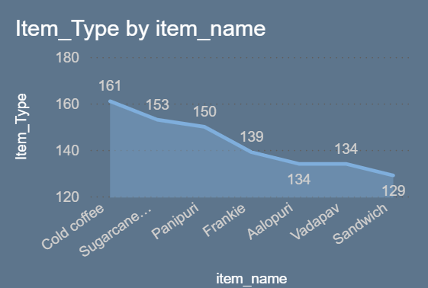
Food Trend Insights: Revenue Analysis
Revenue analysis helps identify which products generate the highest income for the restaurant. By examining revenue by product, we can determine which menu items are the most profitable. High-revenue products contribute significantly to overall business growth and should be promoted or maintained consistently.
If a product has high sales but low revenue, pricing strategies may need adjustment. Similarly, low-revenue products may require improvement in quality, marketing, or removal from the menu. This analysis supports strategic decision-making to maximize profitability and optimize product offerings

Slide 8
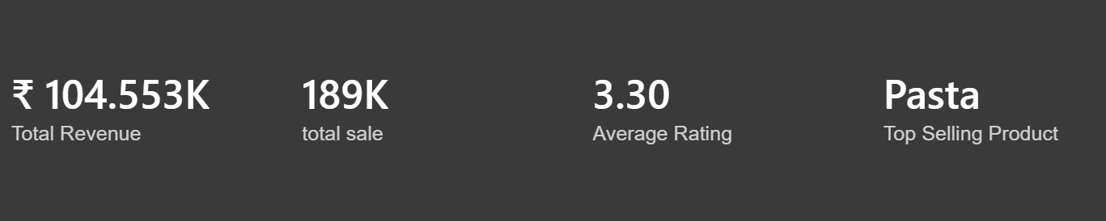
KPI Analysis
Key Performance Indicators (KPIs) are used to measure the overall performance of the restaurant. In this dashboard, four important KPIs are created: Total Revenue, Total Sales, Average Rating, and Top Selling Product.
Total Revenue shows the total income generated from all product sales. Total Sales represents the total quantity of items sold. Average Rating indicates the level of customer satisfaction based on customer feedback. The Top Selling Product identifies the most popular menu item among customers.
These KPIs provide a quick overview of business performance and help management make data-driven decisions to improve sales and customer satisfaction.

Slide 9
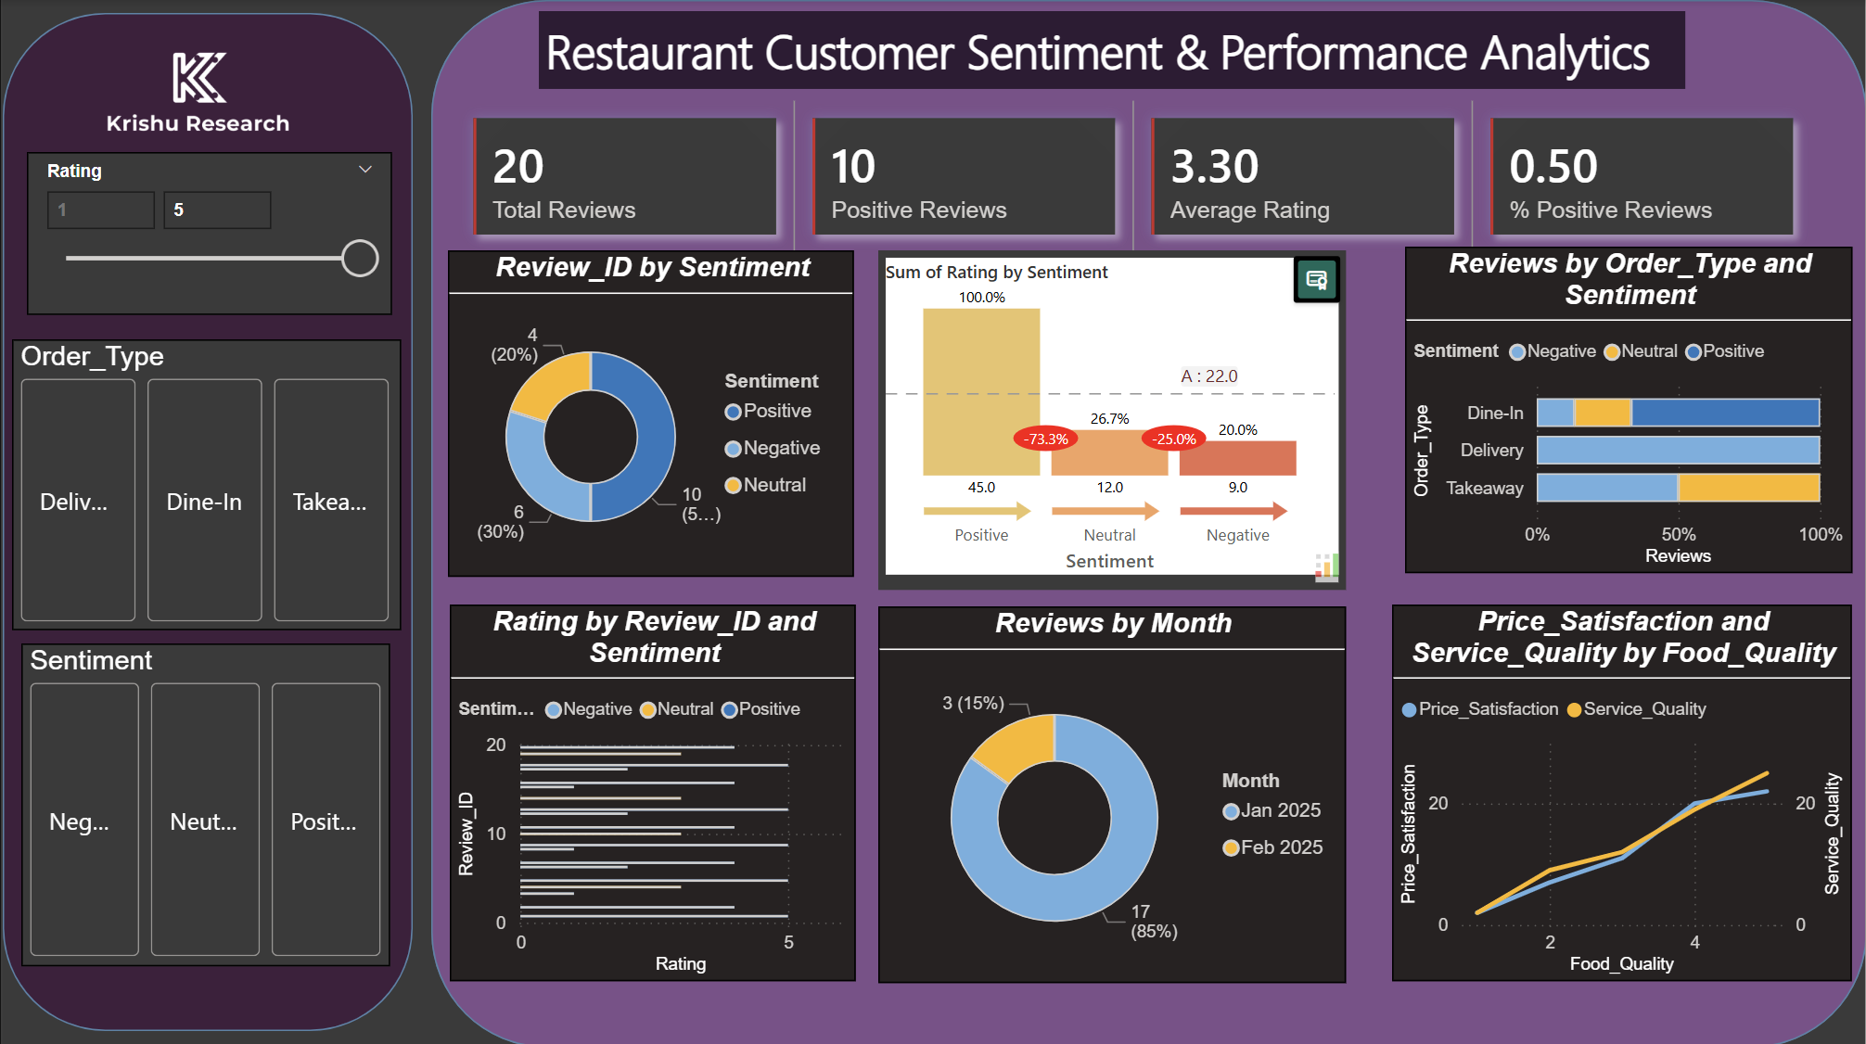
Sentiment Insights
Sentiment insights help analyze customer opinions and satisfaction levels based on their feedback. In this dashboard, customer reviews are categorized into three types: Positive, Neutral, and Negative. This classification helps understand how customers feel about the restaurant’s products and services.
By examining the sentiment distribution, we can identify the percentage of satisfied and dissatisfied customers. A higher number of positive reviews indicates strong customer satisfaction, while negative reviews highlight areas that require improvement such as food quality, service, or pricing.
These insights help the restaurant improve customer experience and maintain better service quality.

Slide 10
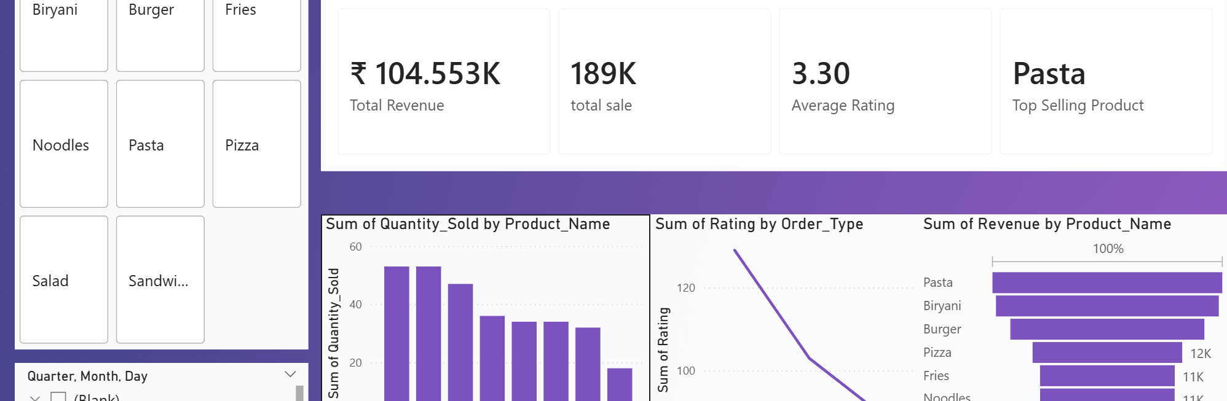
Restaurant Product Insight Dashboard
The Restaurant Product Insight Dashboard helps analyze the performance of different menu items. It provides valuable insights into product sales, revenue generation, and customer ratings. By examining product-wise performance, the dashboard helps identify which menu items are most popular and which contribute the most to overall revenue.
This analysis enables restaurant management to understand customer demand and adjust product strategies accordingly. High-performing products can be promoted to increase profitability, while low-performing items may require improvements in quality, pricing, or marketing.

Slide 11
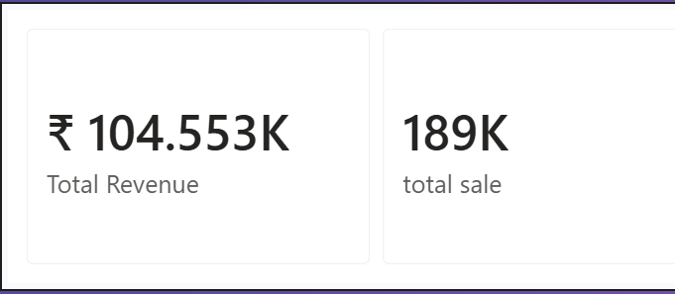
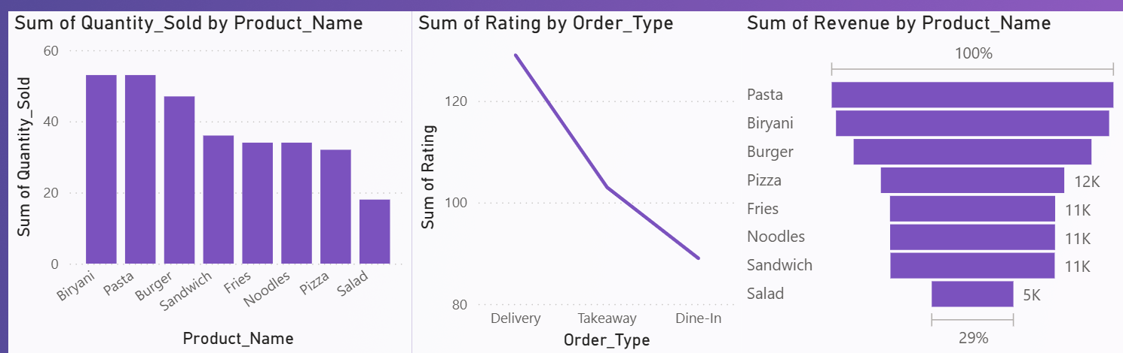
Revenue Analysis
Revenue analysis helps understand which products contribute the most to the restaurant’s total income. By analyzing revenue generated by each product, we can identify high-performing items that drive business growth. Products with higher revenue indicate strong customer demand and profitability.
This analysis helps management focus on promoting profitable menu items and optimizing pricing strategies. It also highlights products that generate lower revenue, which may require improvements in quality, marketing, or pricing. Overall, revenue analysis supports better business decisions and helps increase overall restaurant profitability.

Slide 12
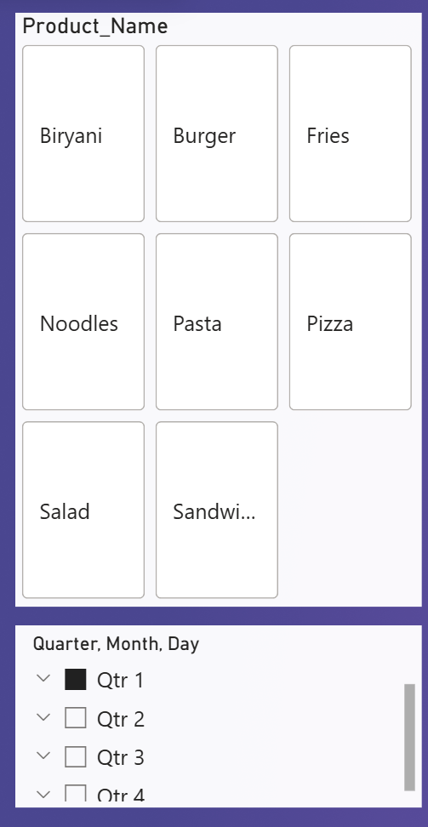
Interactive Slicer
Interactive slicers are used to filter and analyze data dynamically within the dashboard. In this project, slicers are added for Product Name and Quarter. These slicers allow users to select specific products or time periods and instantly update all visuals on the dashboard.
This feature helps users focus on particular data segments and perform detailed analysis. For example, selecting a specific product will display its sales, revenue, and rating information across all charts. Interactive slicers improve dashboard usability and make the analysis more flexible and user-friendly.

Slide 13
Conclusion
In conclusion, this project demonstrates how data analytics can help restaurants gain valuable insights from sales and customer feedback data. By using Power BI dashboards, we analyzed food trends, customer sentiment, and product performance. The use of KPIs, charts, and slicers helped transform raw data into clear and interactive visual insights.
This analysis helps identify top-selling products, understand customer preferences, and evaluate overall business performance. With these insights, restaurant management can make better data-driven decisions, improve customer satisfaction, and increase revenue. Overall, this project highlights the importance of data-driven strategies in improving restaurant operations and business growth.

Slide 14
Thank You & Questions
Thank you for your time and attention. This presentation demonstrated how data analytics and Power BI dashboards can help understand food trends, analyze customer sentiment, and evaluate product performance in a restaurant.
By using KPIs, charts, and slicers, the dashboards transform raw data into meaningful insights that support better decision-making and business growth.
I appreciate the opportunity to present this project. If there are any questions or suggestions, I would be happy to answer them.
Thank You
Any Questions?

